Slide 1

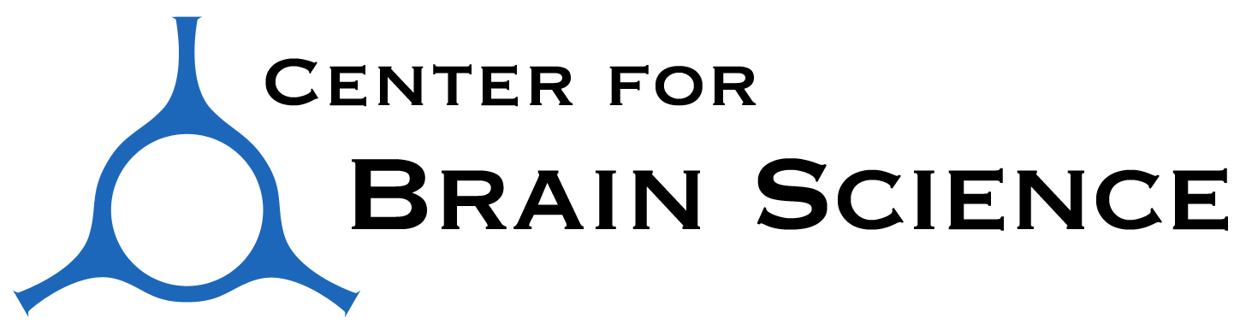
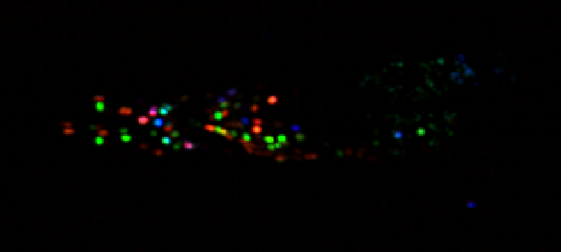
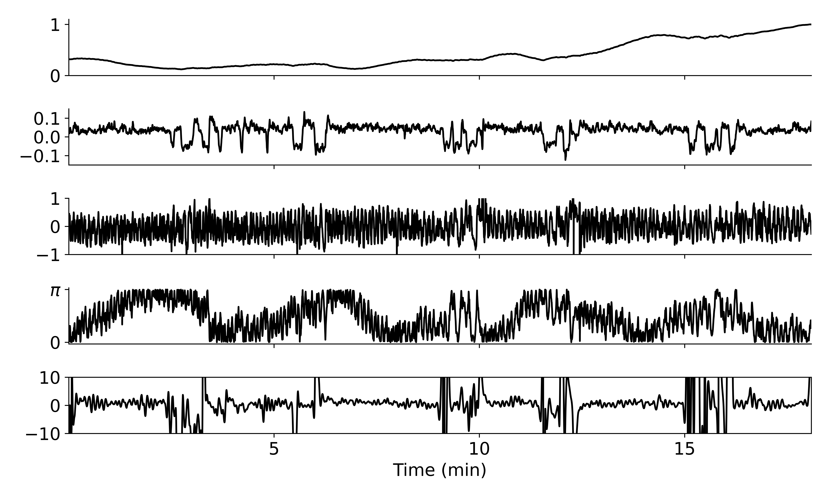
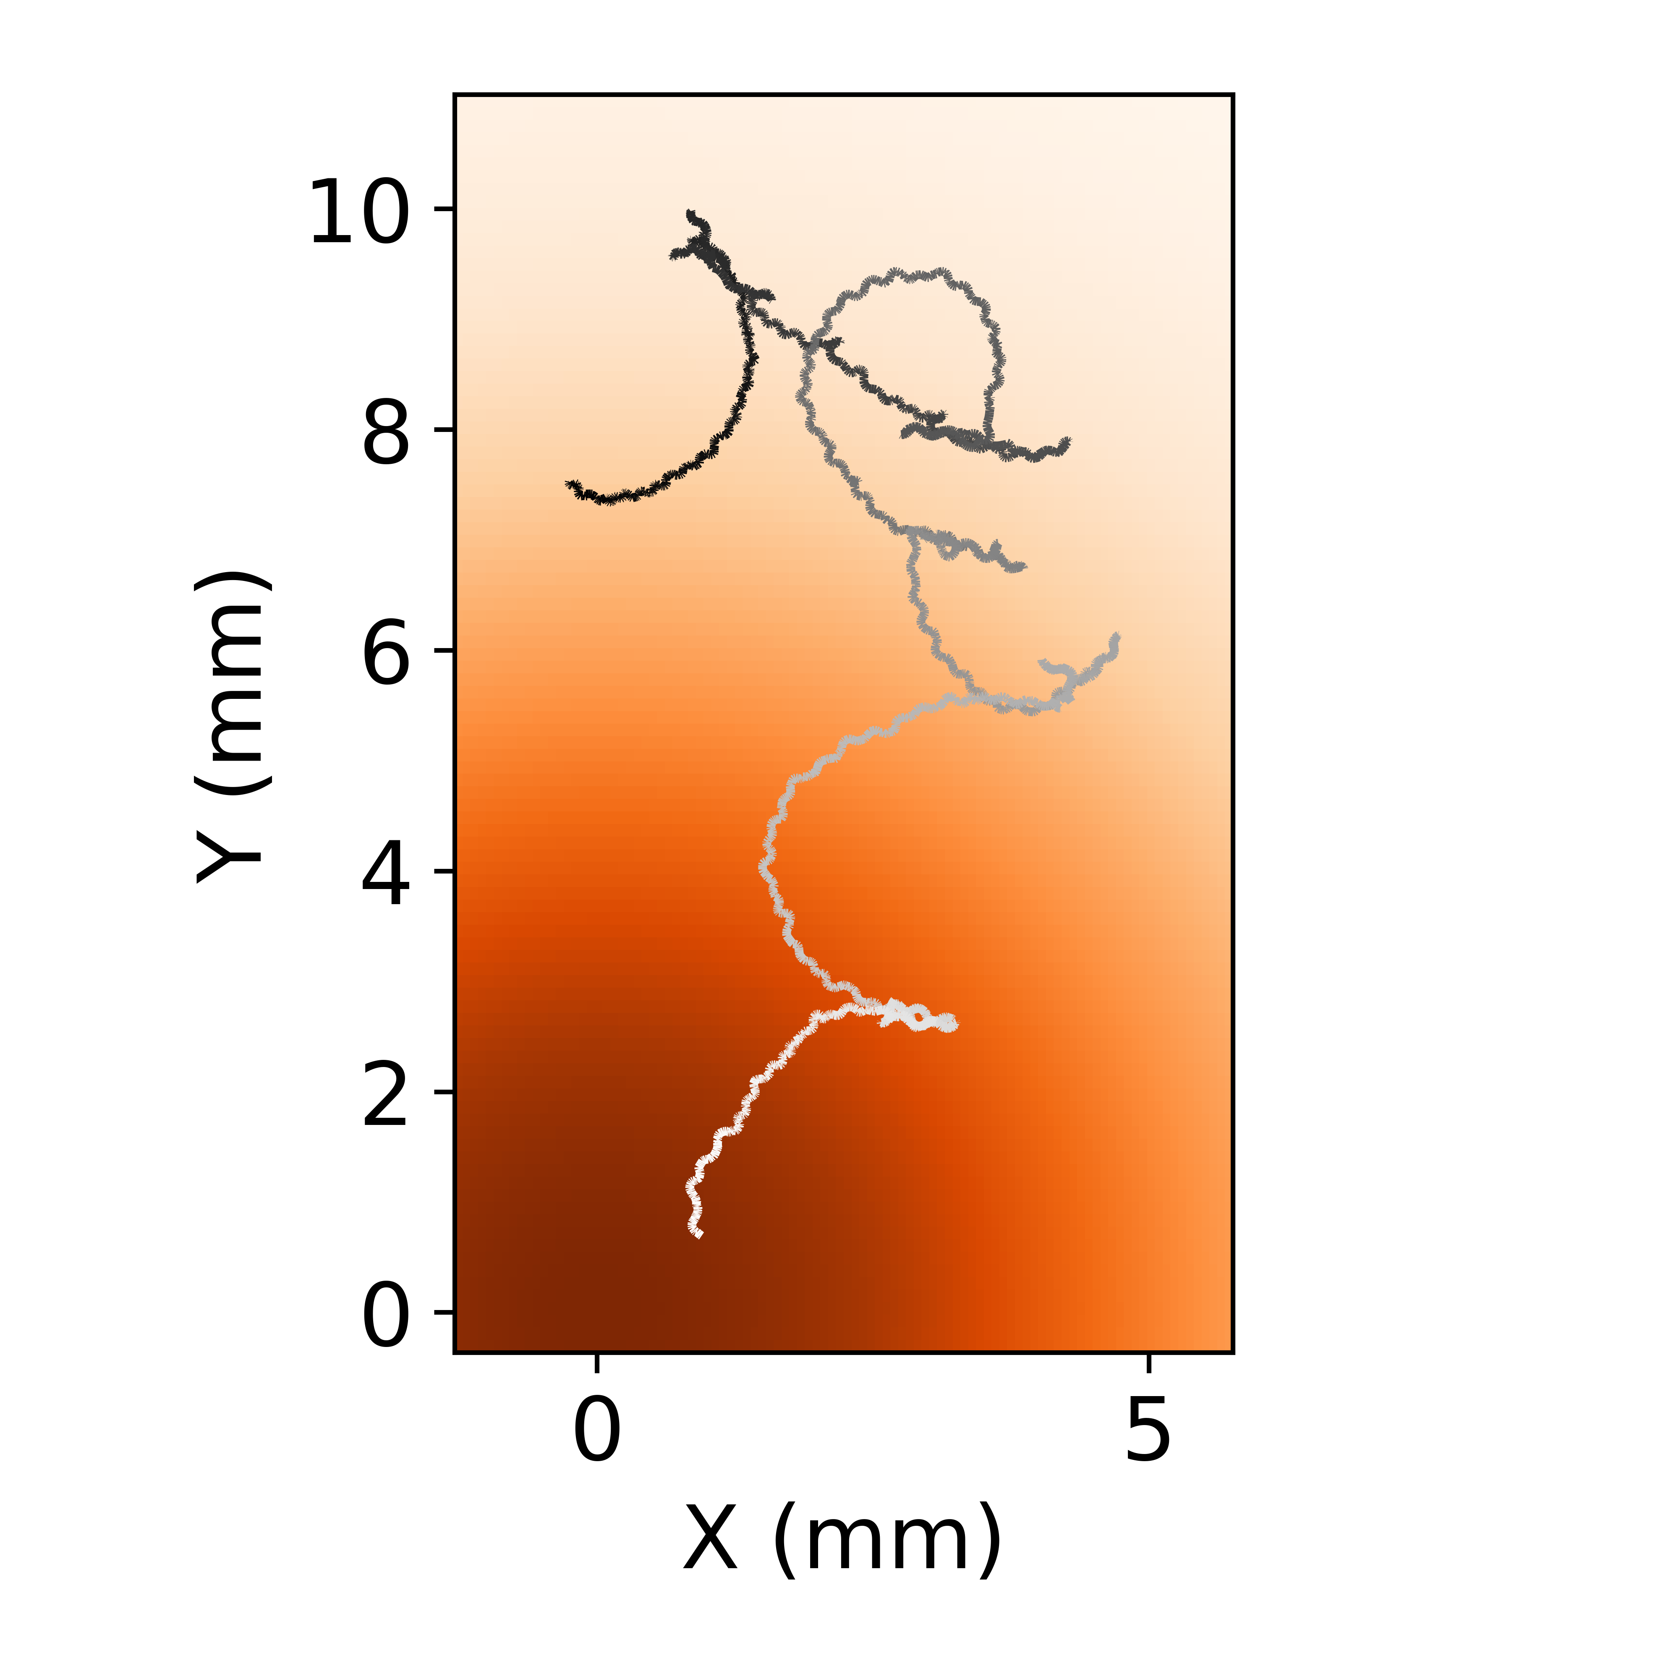
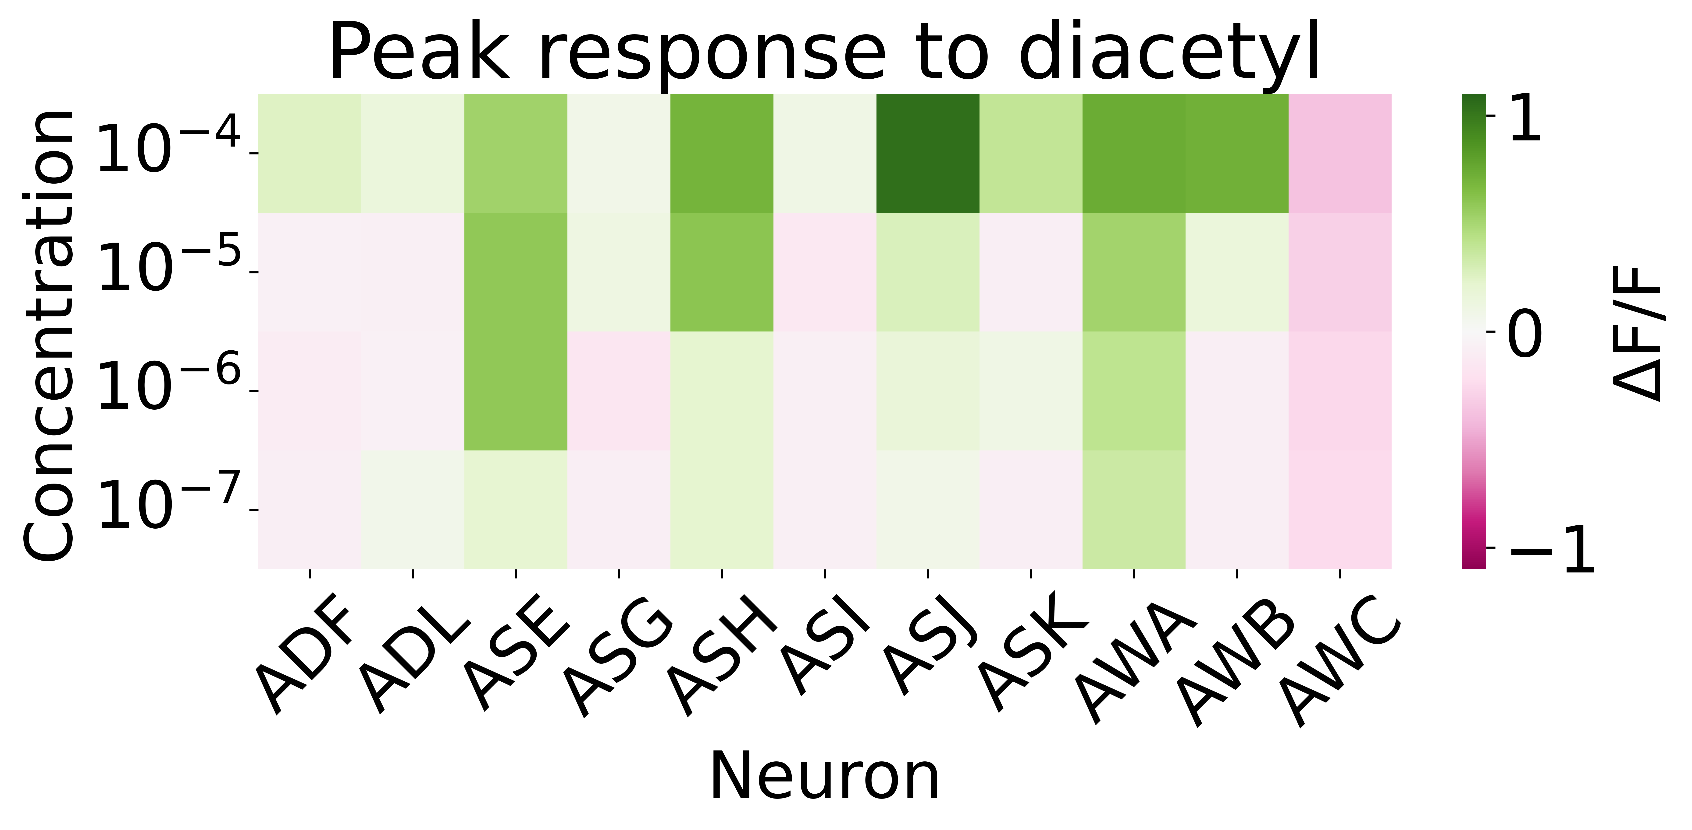
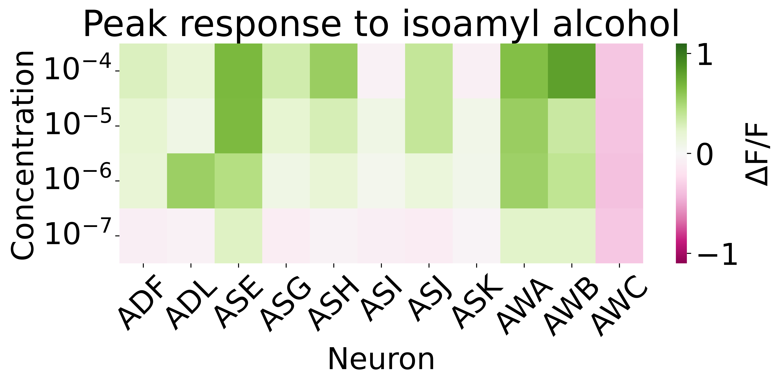
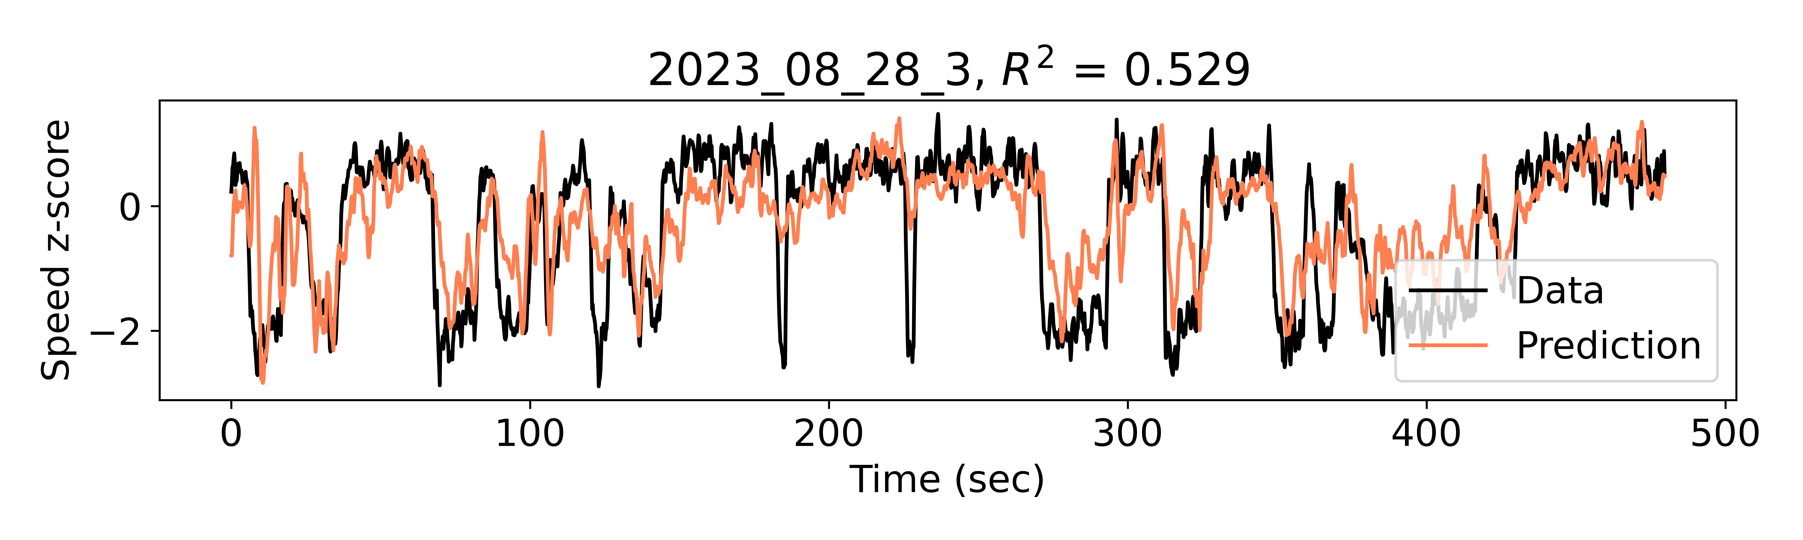
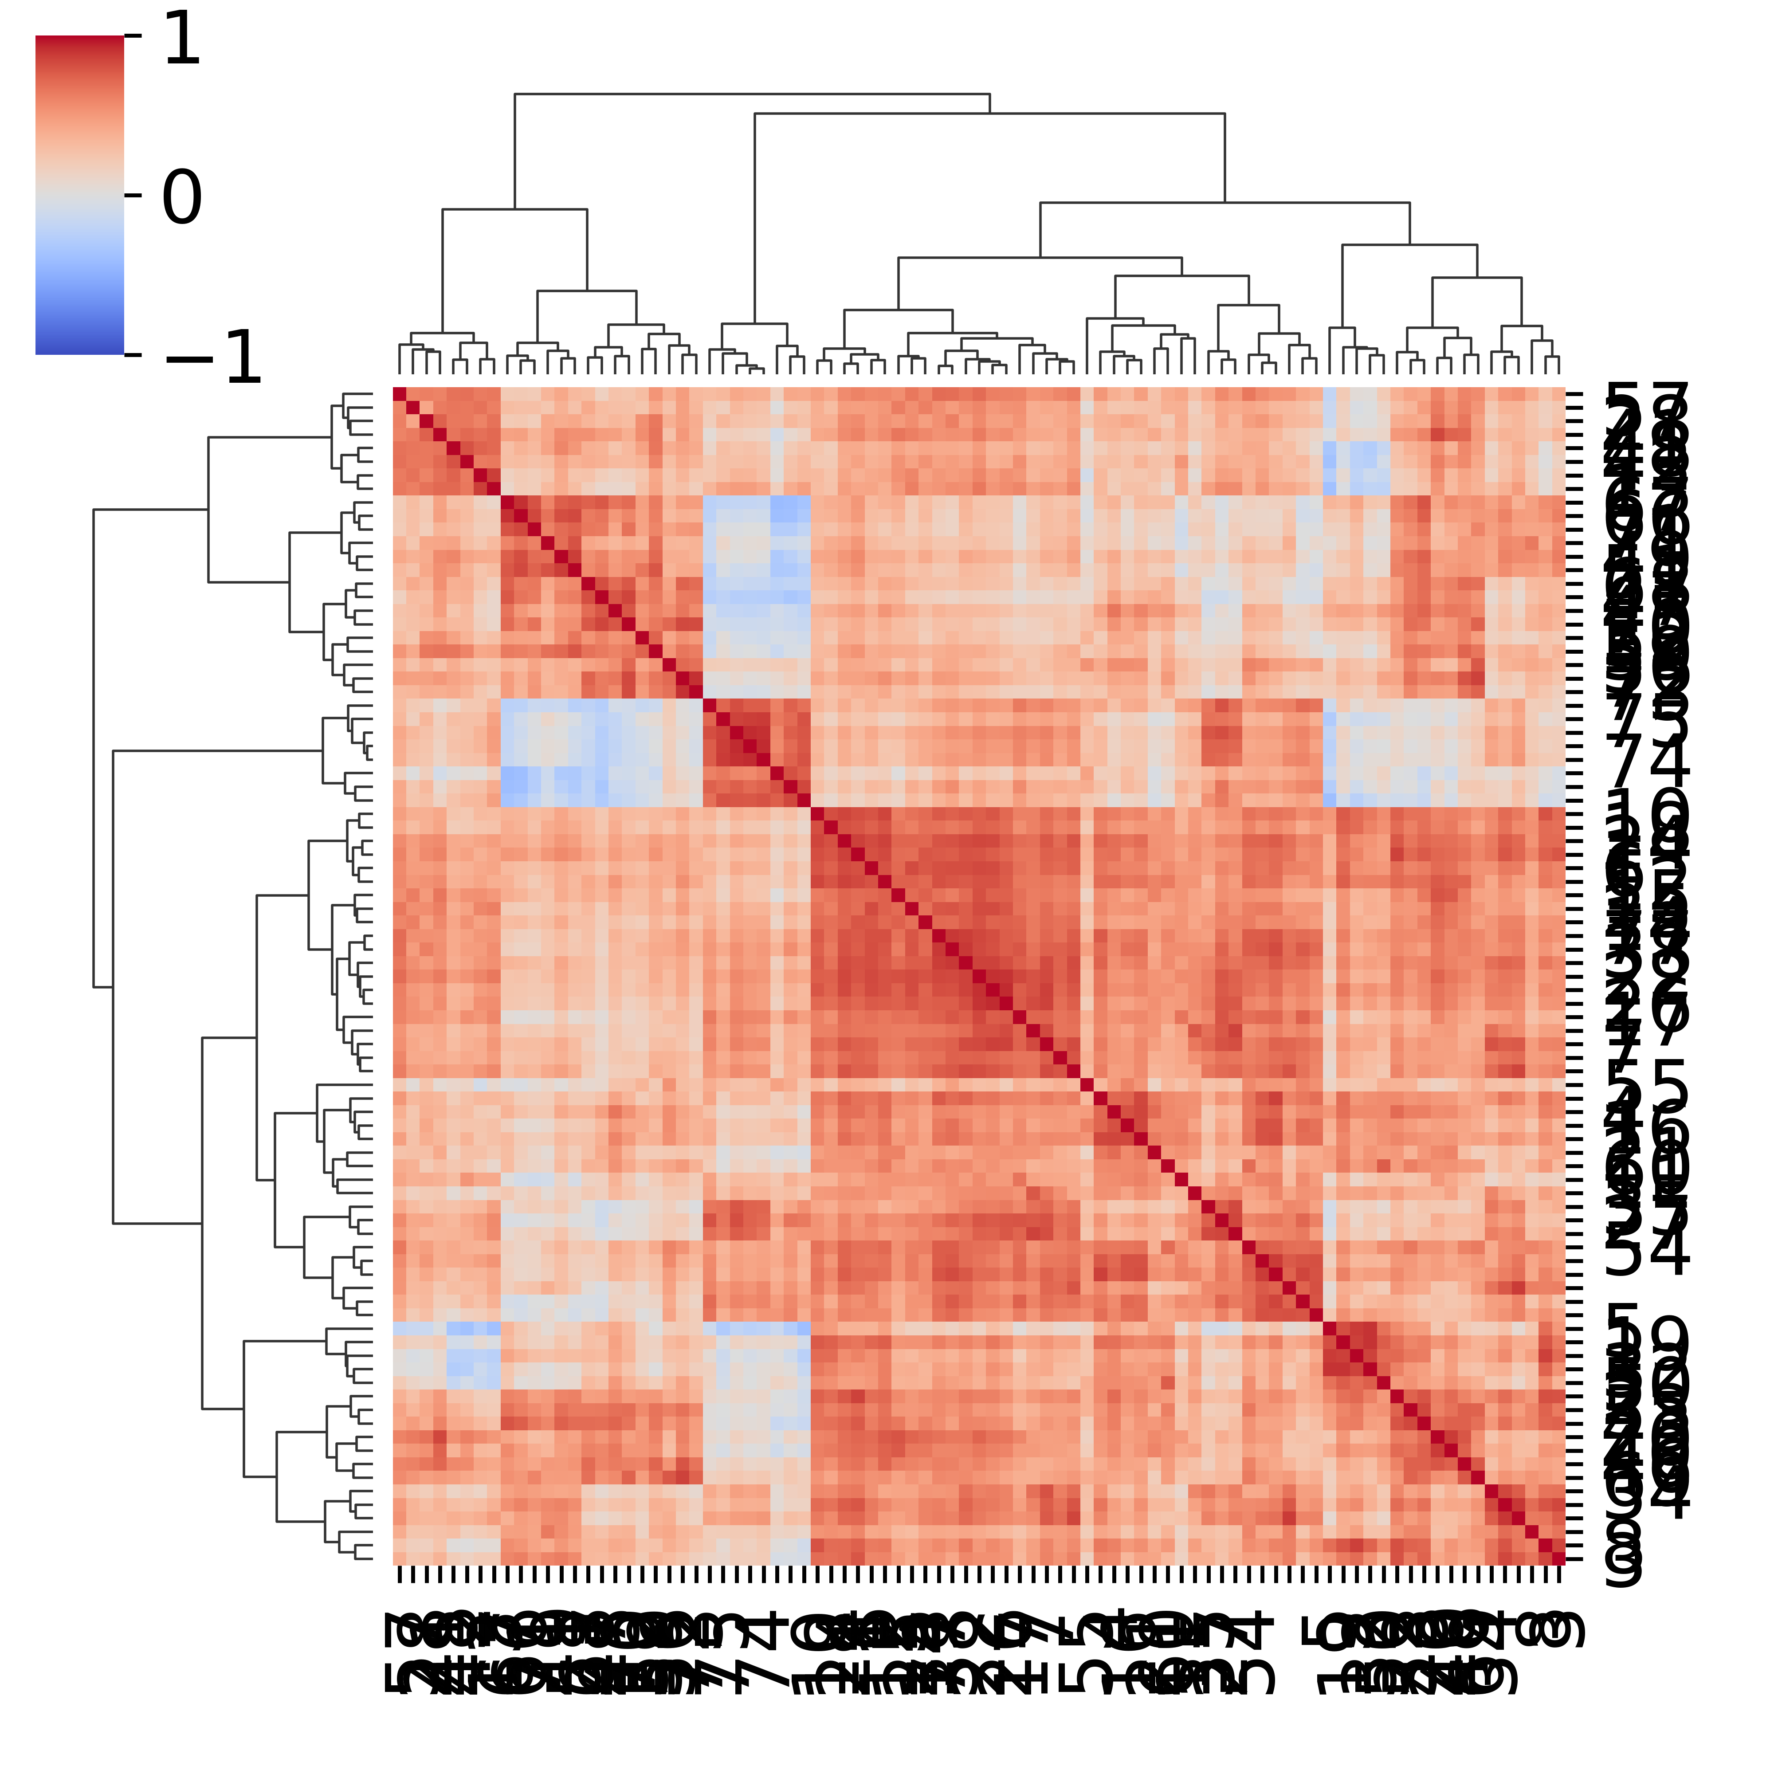
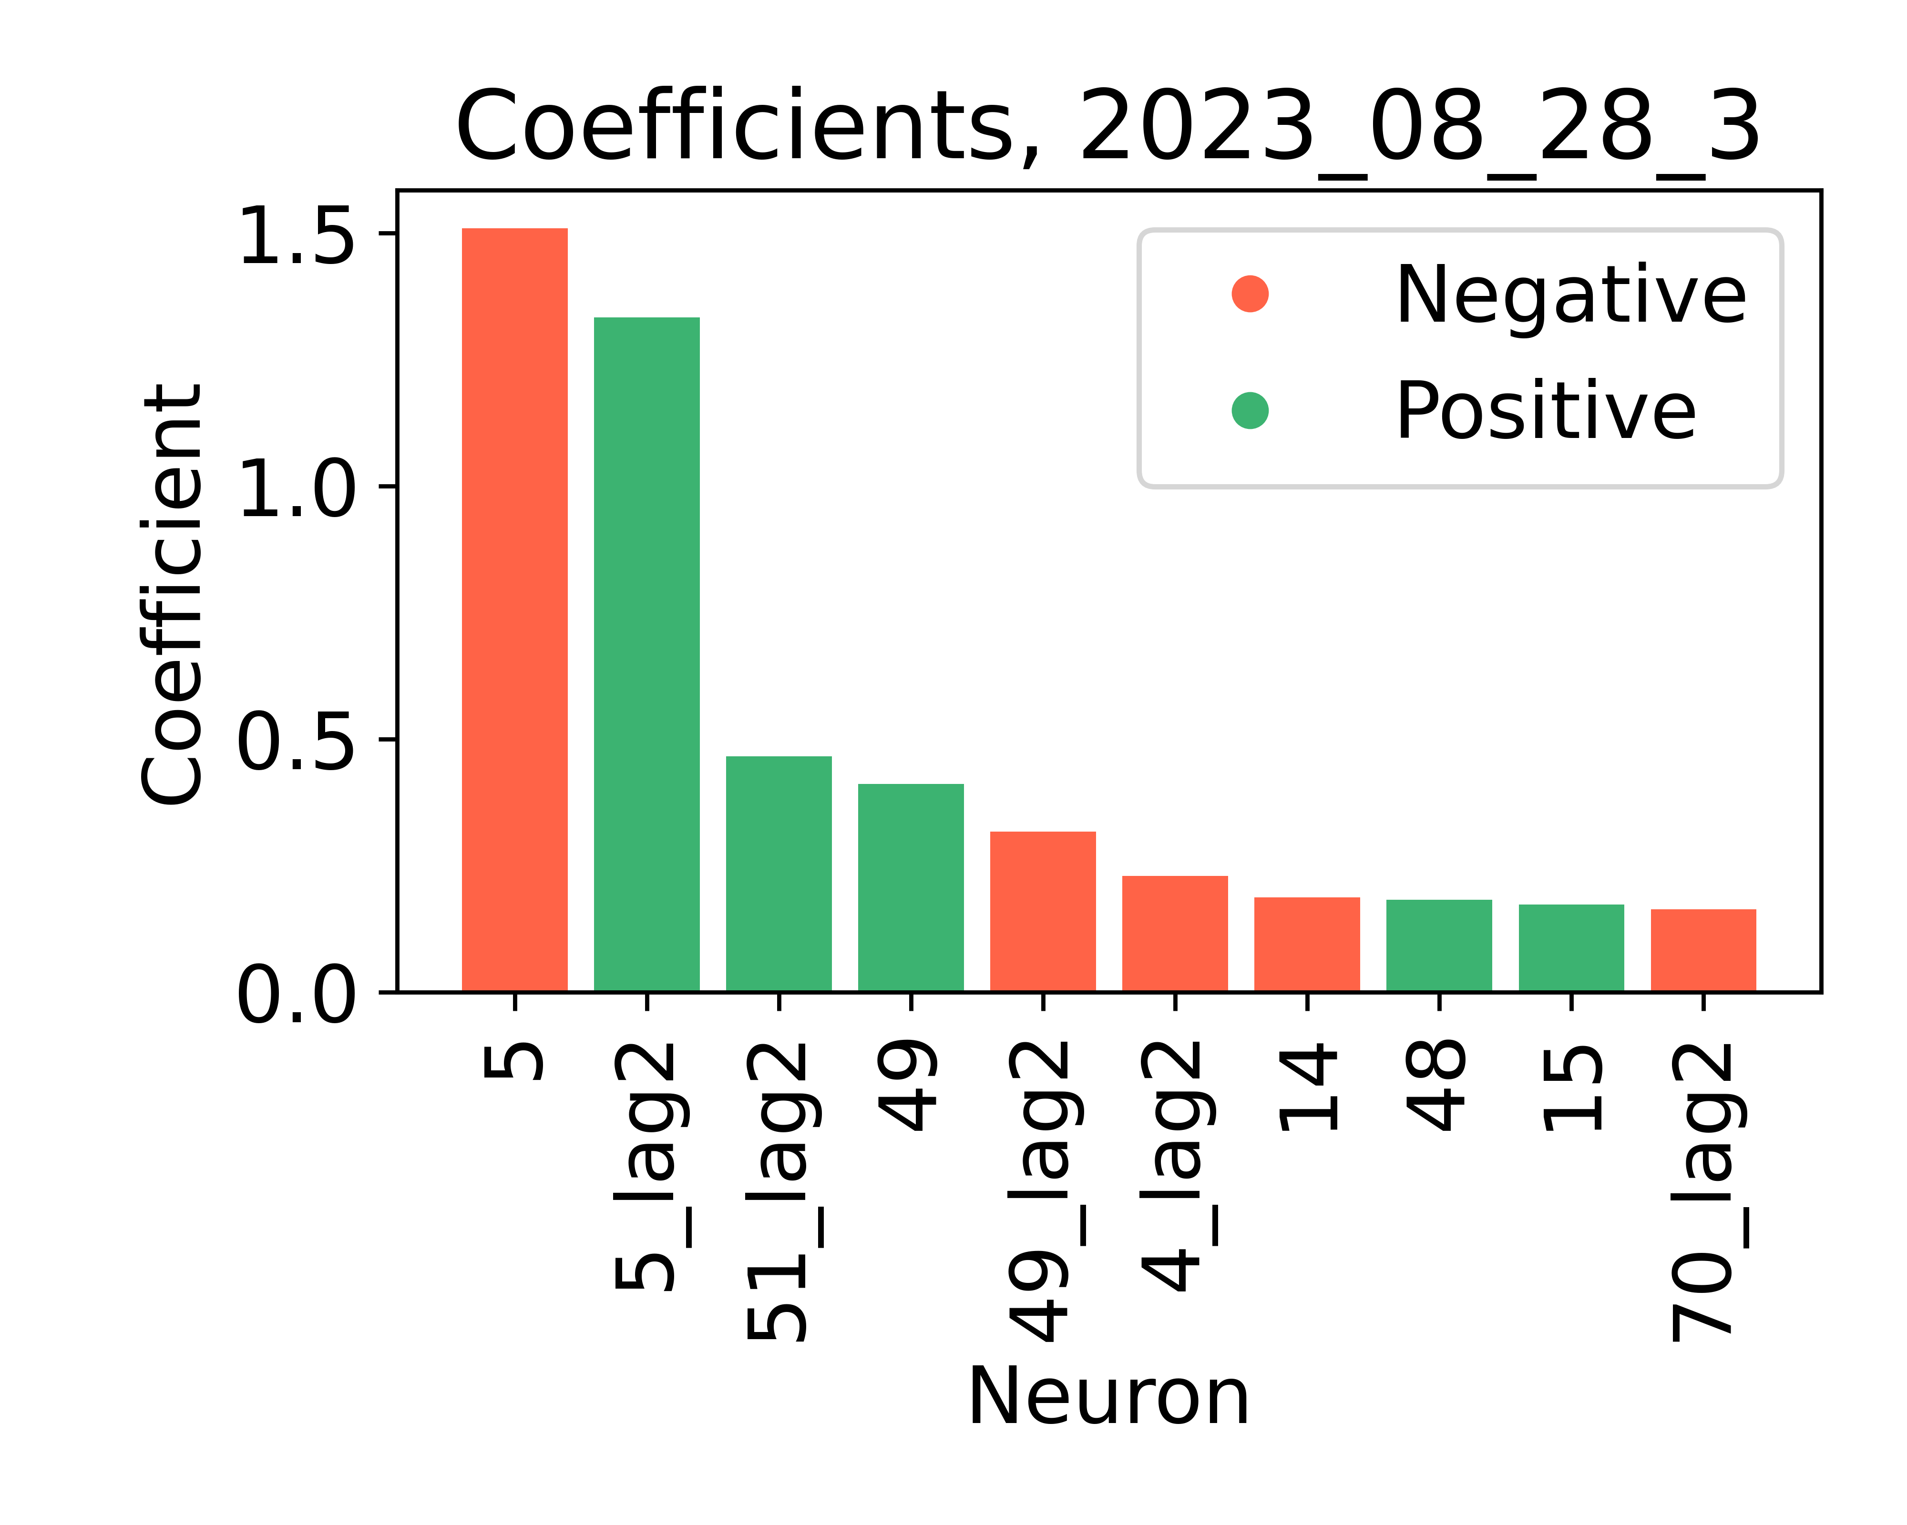
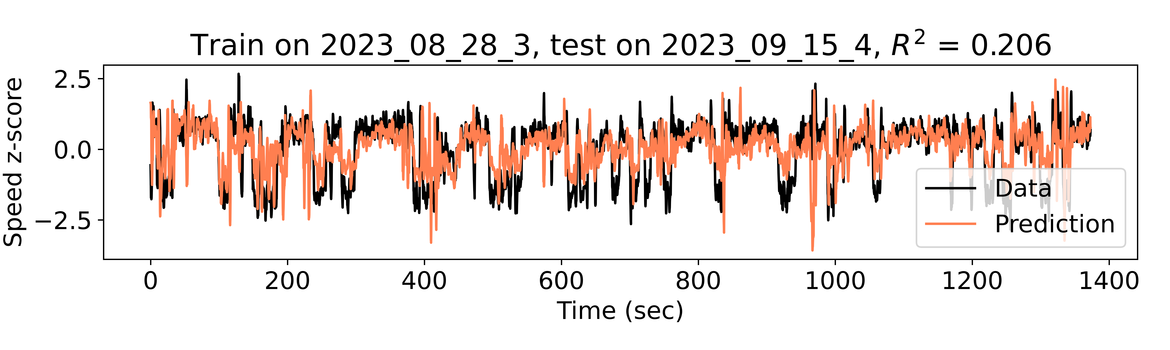
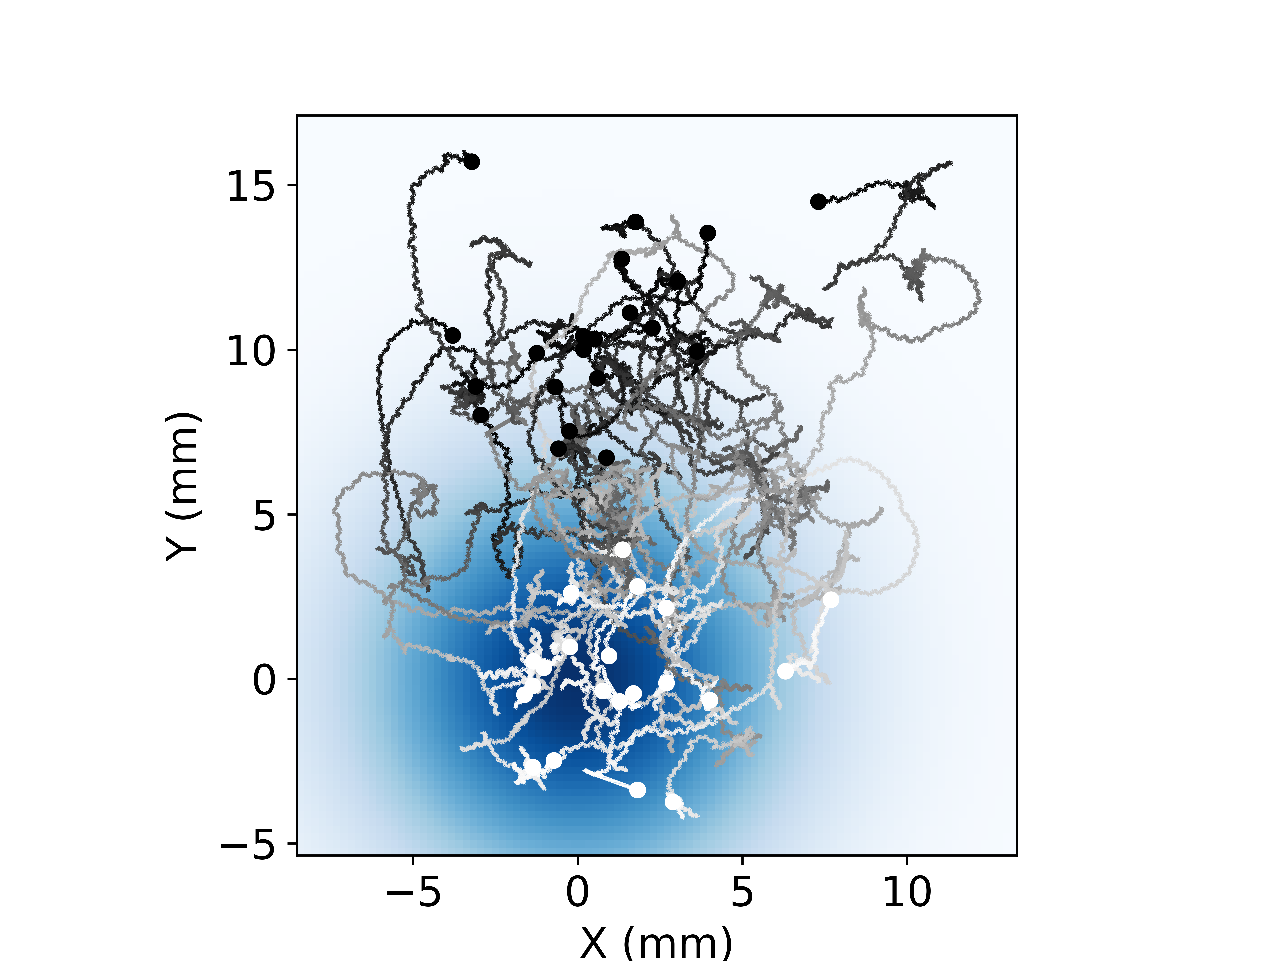
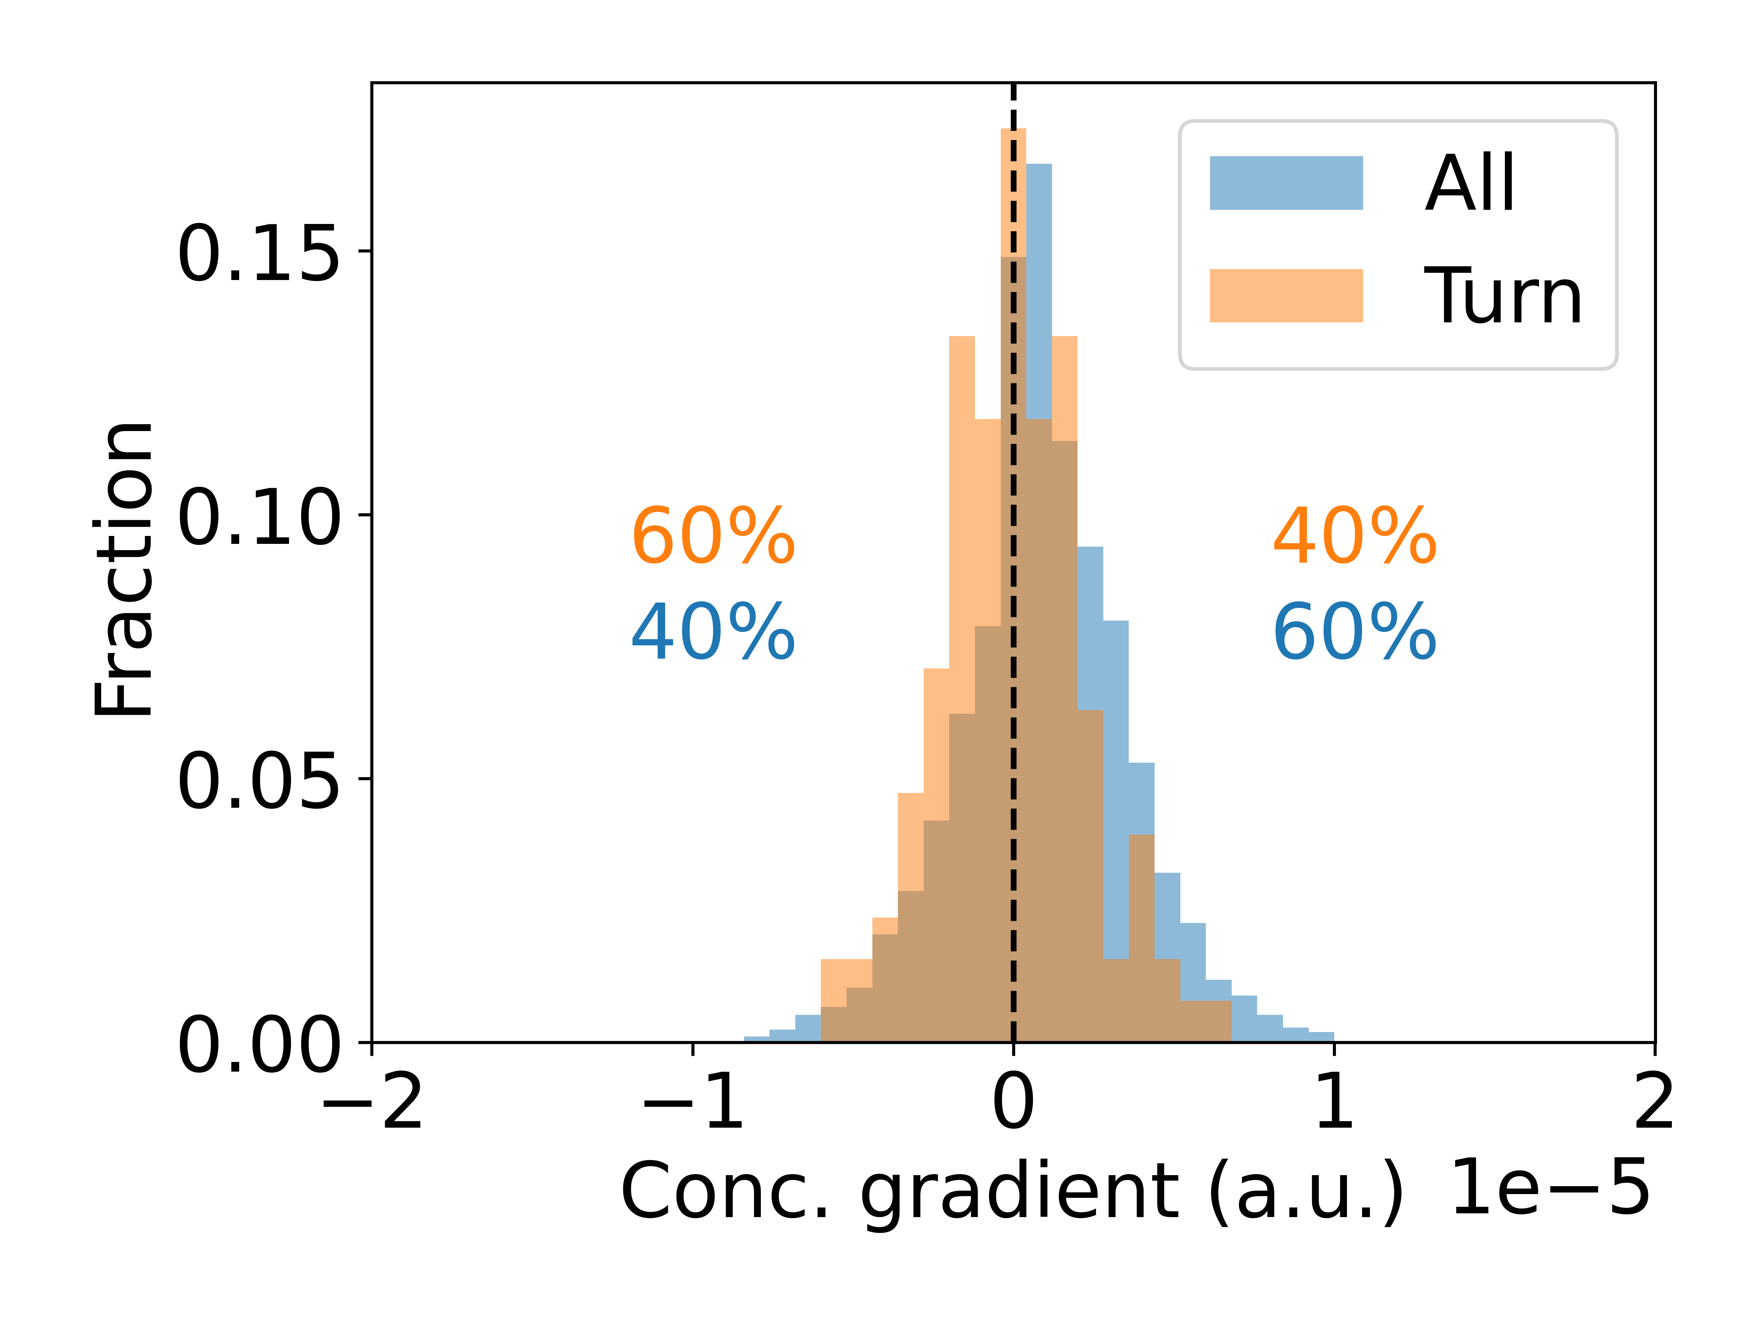
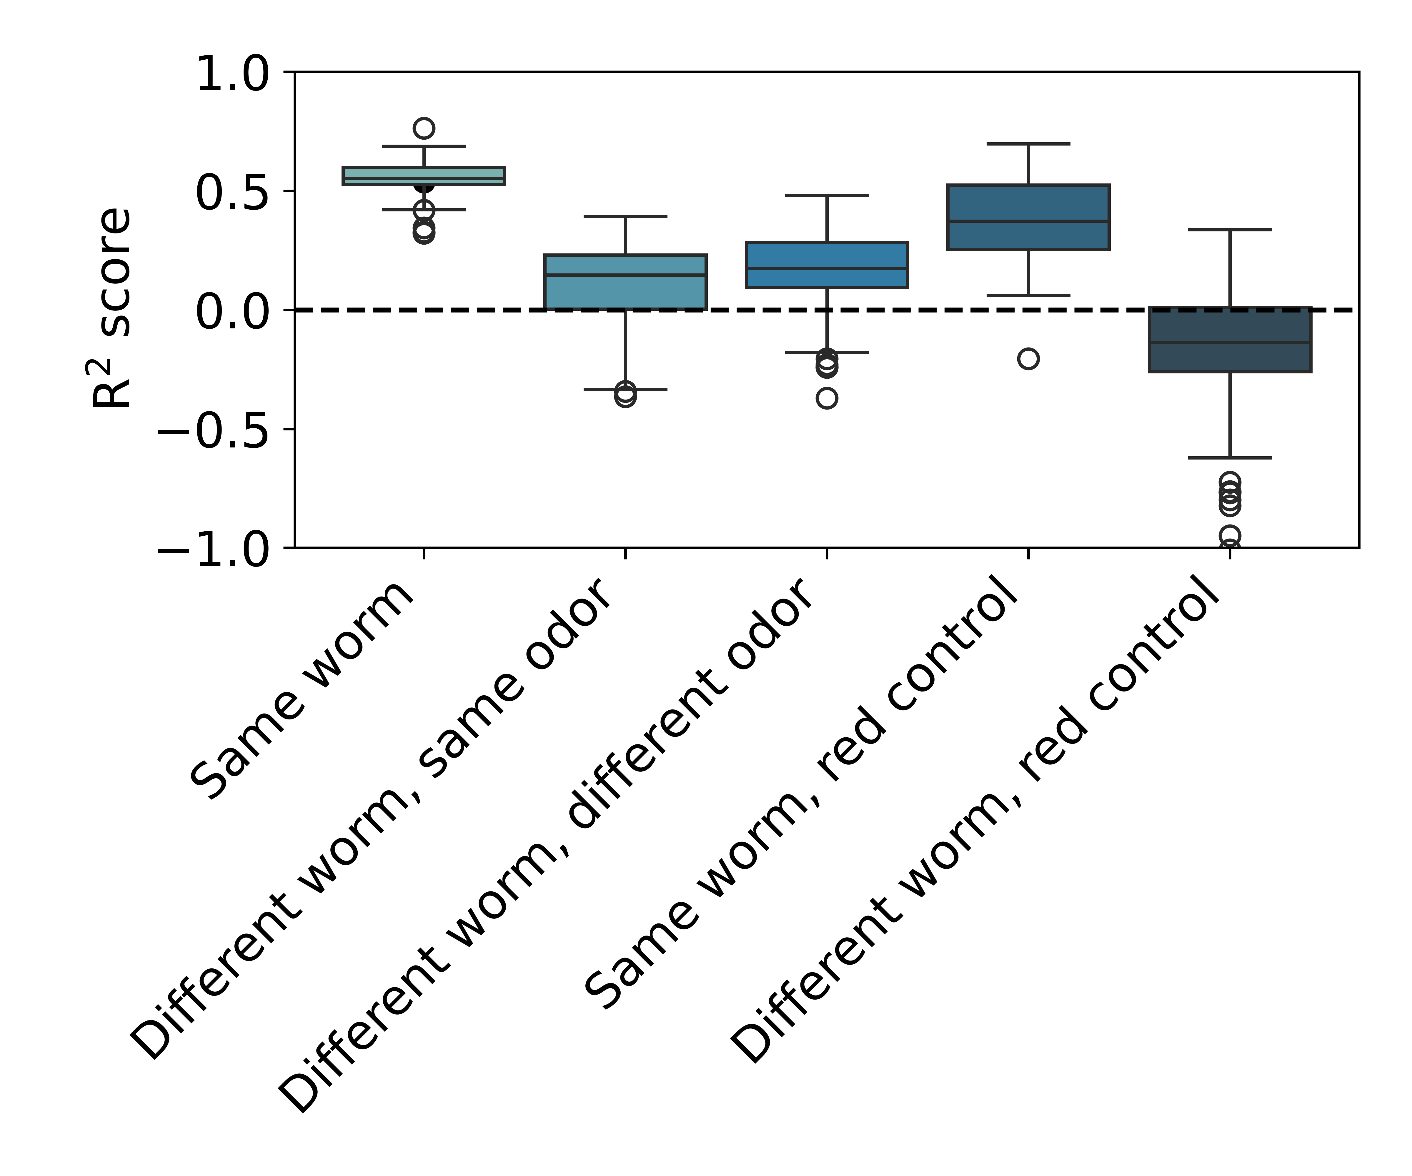
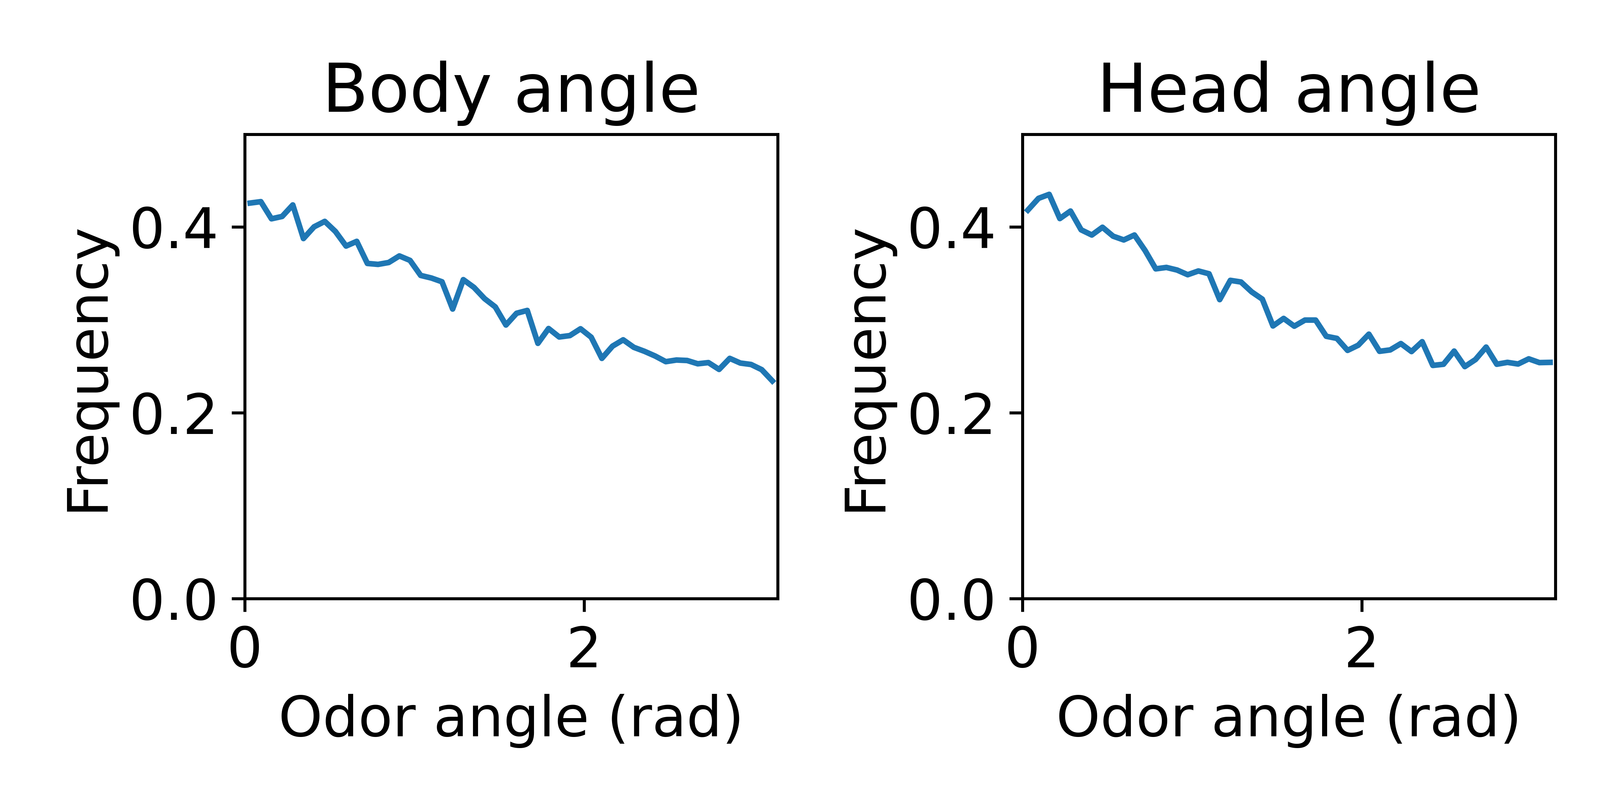
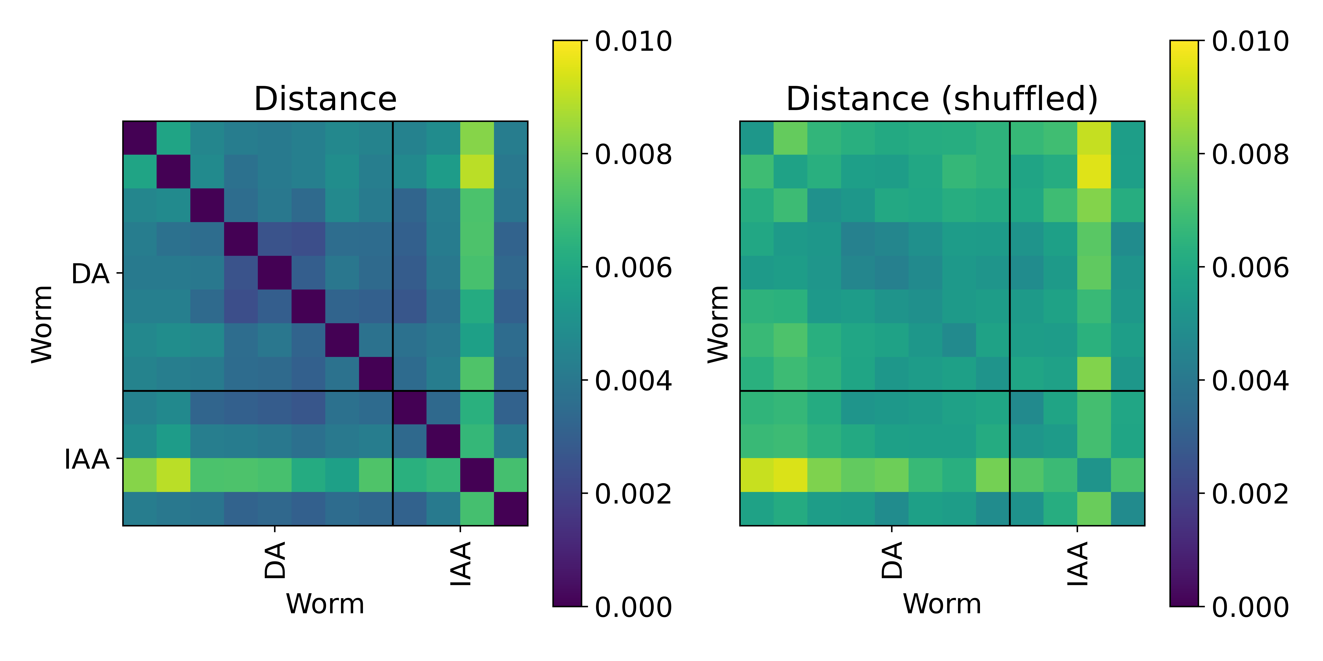
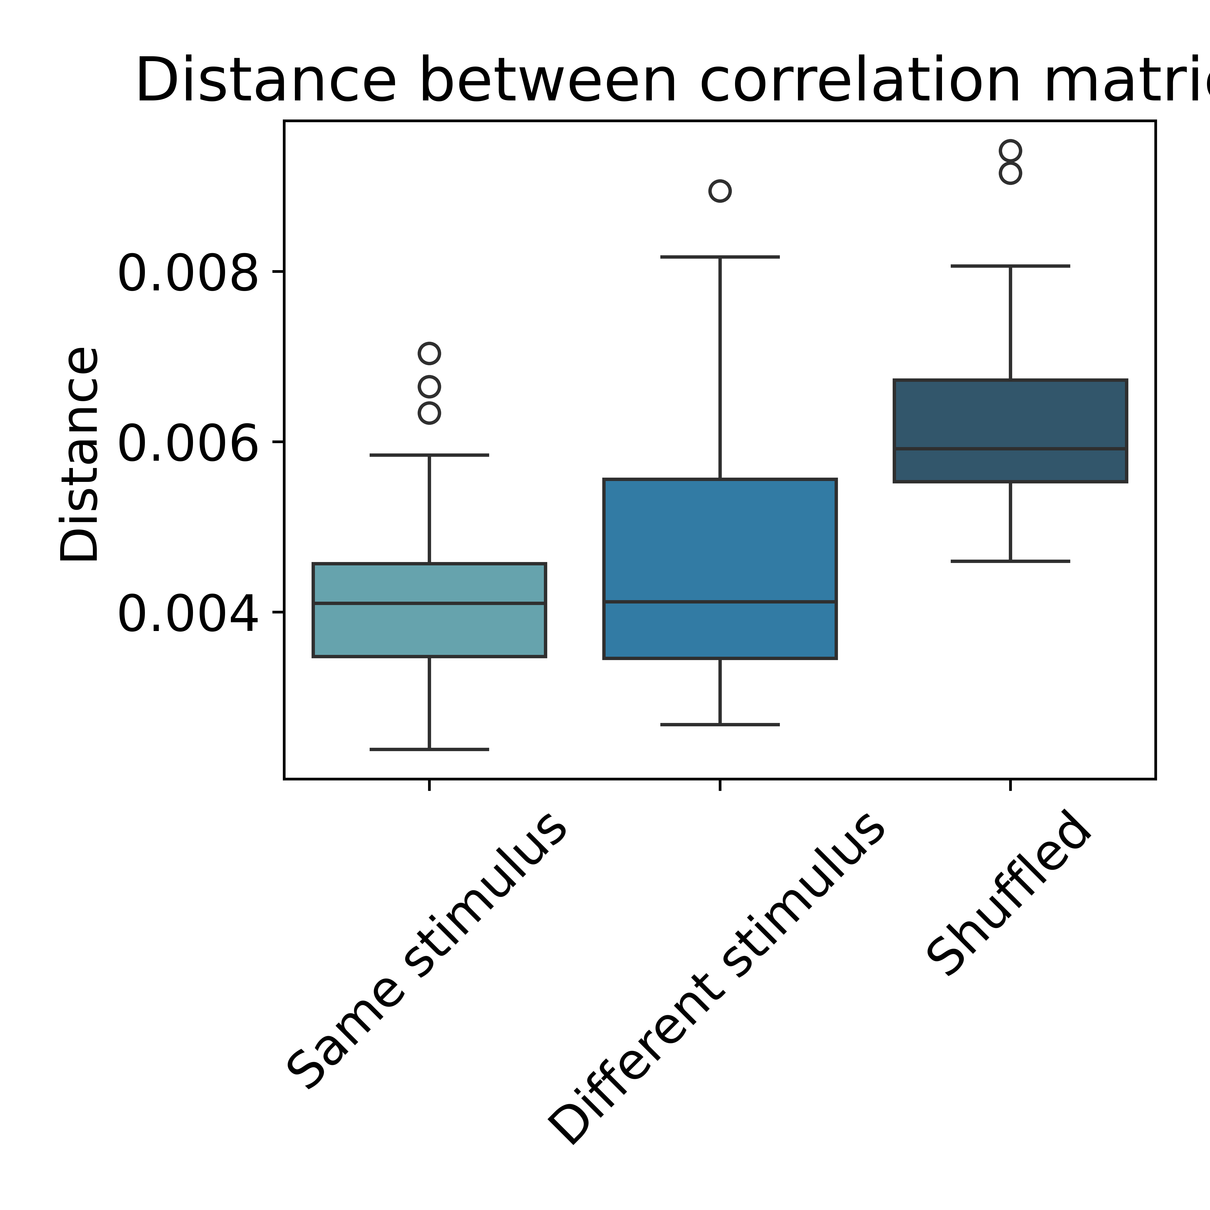
Finding neural representations of navigation strategies using whole-brain imaging of freely moving C. elegans in an odor gradient
Helena Casademunt^{1,2}, Core Francisco Park^{1,2}, Albert Lin³, Hongruo Zhang⁴,
John Laver⁵, John Calarco⁵, Mei Zhen⁶, Aravinthan D. T. Samuel^{1,2}
¹ Department of Physics, Harvard University, Cambridge, MA, USA; ² Center for Brain Science, Harvard University, Cambridge, MA, USA; ³ Center for the Physics of Biological Function, Princeton University, Princeton, NJ, USA; ⁴ Department of Physiology, University of Toronto, Toronto, ON, Canada; ⁵ Department of Cell & Systems Biology, University of Toronto, Toronto, ON, Canada; ⁶ Lunenfeld-Tanenbaum Research Institute, Mount Sinai Hospital, Toronto, ON, Canada.
Contact: hcasademunt@g.harvard.edu
Abstract. We record whole-brain activity of animals freely navigating in an attractive odorant gradient to understand how neural activity encodes gradient information and how this leads to probabilistic navigation strategies. We can measure whole-brain activity with neuron identities, behavior, and changes in experienced odorant concentration at the same time. By finding how neural activity relates to sensory and behavioral variables, we hope to understand how the brain senses information from a complex environment and how it integrates this information with internal states to generate behavior.
Whole-brain activity and behavior
Experiment
We create an odor gradient on agar and record whole-brain activity of worms freely navigating
odor source
coverslip
agar pad
Conc. (a.u.)
Forward
Speed (mm/s)
Backward
We perform calcium imaging using a multicolor label strain to identify neurons
Introduction: C. elegans olfaction and navigation behavior
Head curvature (rad)
Head orientation (rad)
Predicting behavior using linear
regression with time lags
Worms use a combinatorial code to identify odorants. We study two attractants, sensed by different sets of chemosensory neurons (figs. adapted from [1]).
Trajectory curvature (rad/mm)
Neurons predictive of speed
Test data from the same worm
Whole-brain activity correlation structure
Correlation matrix of a single worm
R² = 0.53
Tested on a different worm
Worms navigate towards the odorant by combining directed curving up the gradient with occasional pirouette reorientations.
AVA
RIP
RIP*
ASK
ADL
AVA*
RME
.
57
28
41
48
42
.
13
67
66
71
.
49
51
68
47
45
70
52
59
56
72
73
.
75
.
.
74
.
.
.
10
18
24
1
6
12
15
25
14
77
38
.
22
.
26
17
.
7
.
.
55
.
4
16
.
21
60
11
.
35
27
.
54
.
.
.
.
.
5
19
.
32
50
2
53
43
20
40
46
69
34
.
.
.
8
3
URB*
RMDV*
MCL*
OLQD
CEPD
RID
RME
RMED
AVB
IL1V
* lag
M4
IL1
Neurons
R² = 0.21
URB
RIP
URAD
MI
MCL
IL2D
URYV
IL2
NSM
URAV
I2
ADE
ADA
AVE
AWA
AWB
RIA
We can predict speed of a different worm, regardless of stimulus.
We cannot predict other behaviors or stimulus using linear models.
ASH
12
Speed prediction accuracy
Worms are more likely to turn when going down gradient
ADL
RIB
start
ASK
AUA
Neurons
ASJ
ASG
AIN
ASI
IL2V
AIZ
RMDV
SMDD
CEPV
RIV
ADF
M2
35
RMEV
AVA
AIB
OLQV
RIM
IL1
SAAV
URX
BAG
URYD
ALA
34
M3
Neurons
RMD
SMDV
end
Distance between correlation matrices of different worms navigating towards the same or a different odor
Speed along the track
Head orientation
Conclusions and future work
We can record whole-brain activity with neuron identities during free navigation in an attractive odor gradient.
Whole-brain activity shows clear behavioral correlates, but finding representations of some behaviors and stimulus encoding is ongoing work.
Global brain correlation structure is independent of stimulus identity.
References
[1] Lin et al., 2023, Science Advances.
Funding: NIH R01NS113119-01, NSF POLS PHY-1806818.

Slide 2
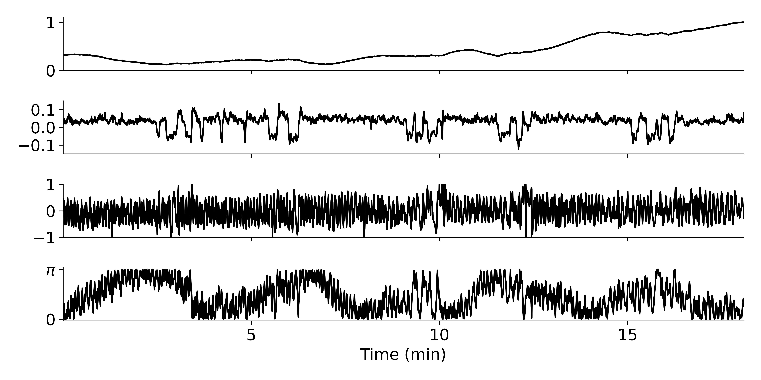
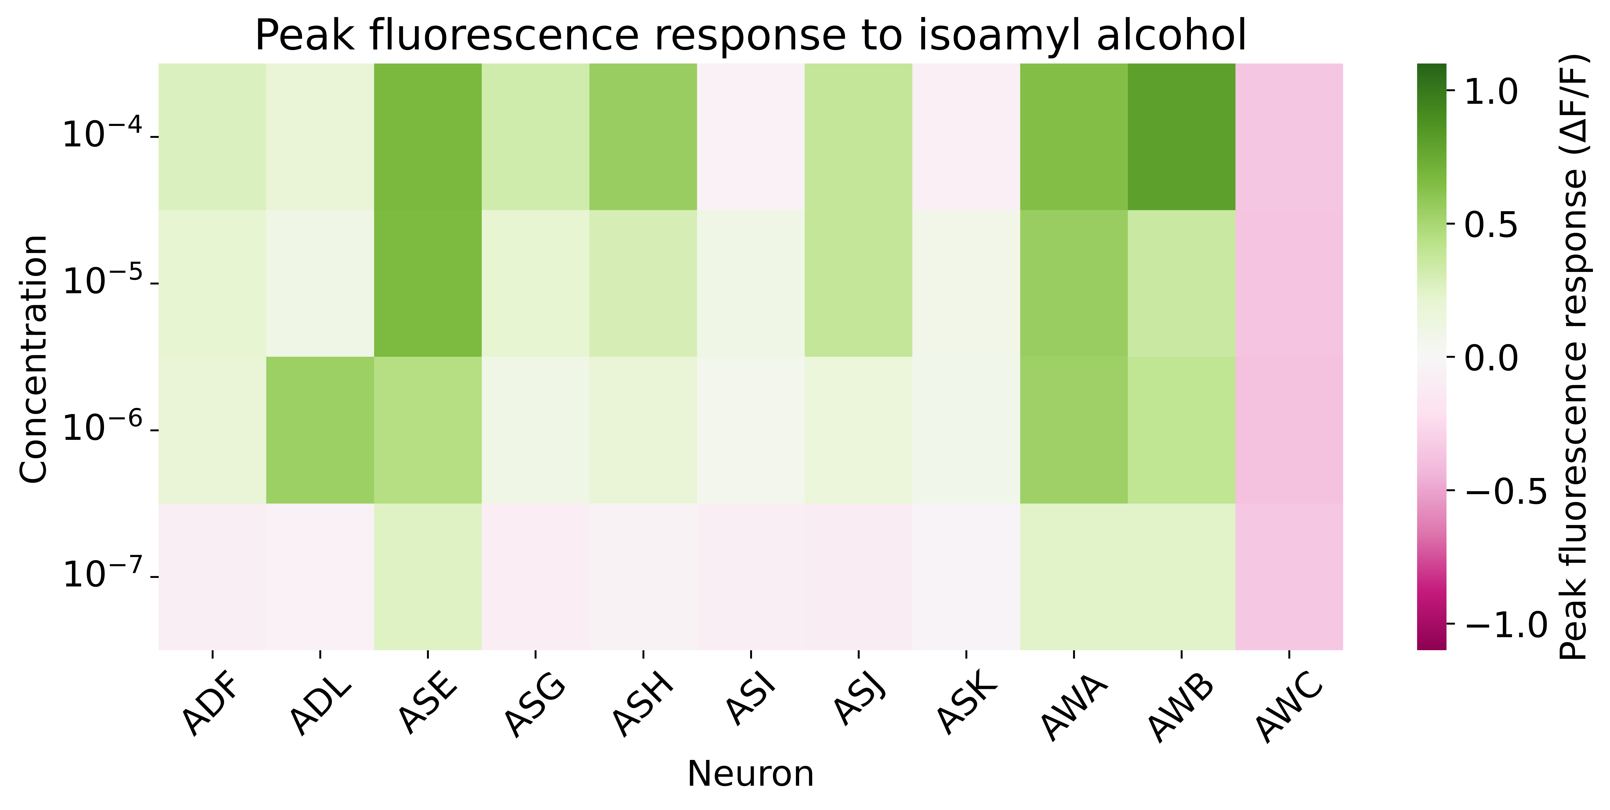
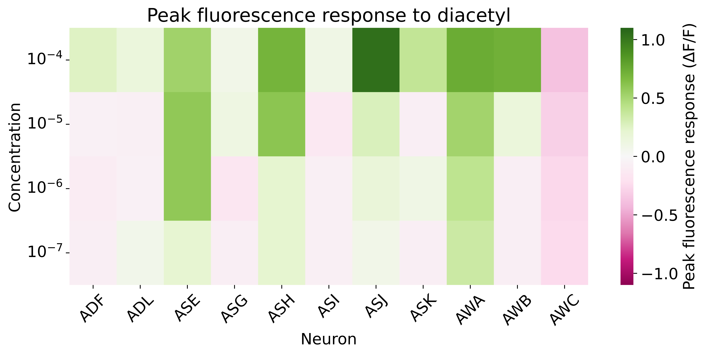
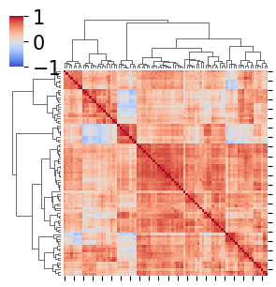
Finding neural representations of navigation strategies using whole-brain imaging of freely moving C. elegans in an odor gradient
Helena Casademunt^{1,2}, Core Francisco Park^{1,2}, Albert Lin³, Hongruo Zhang⁴,
John Laver⁵, John Calarco⁵, Mei Zhen⁶, Aravinthan D. T. Samuel^{1,2}
¹ Department of Physics, Harvard University, Cambridge, MA, USA; ² Center for Brain Science, Harvard University, Cambridge, MA, USA; ³ Center for the Physics of Biological Function, Princeton University, Princeton, NJ, USA; ⁴ Department of Physiology, University of Toronto, Toronto, ON, Canada; ⁵ Department of Cell & Systems Biology, University of Toronto, Toronto, ON, Canada; ⁶ Lunenfeld-Tanenbaum Research Institute, Mount Sinai Hospital, Toronto, ON, Canada.
Contact: hcasademunt@g.harvard.edu
Abstract. We record whole-brain activity of animals freely navigating in an attractive odorant gradient to understand how neural activity encodes gradient information and how this leads to probabilistic navigation strategies. Our experiments allow us to measure whole-brain activity, behavior, and changes in experienced odorant concentration at the same time. By finding how neural activity relates to sensory and behavioral variables, we hope to understand how the brain senses information from a complex environment and how it integrates this information with internal states to generate behavioral decisions.
Whole-brain activity and behavior
Navigation strategies
Worms navigate towards the odorant by combining directed curving up the gradient with occasional pirouette reorientations.
start
end
worms are more likely to turn when going down gradient
heading with respect to odor distribution
speed distribution along the track
Forward
Backward
Background and methods
Predicting behavior using linear
regression with time lags
Worms use a combinatorial code to identify odorants. We study two attractants, sensed by different sets of chemosensory neurons. [1]
Whole-brain activity correlation structure
Neurons predictive of speed
Test data from the same worm
Correlation matrix of a single worm
R² = 0.53
Tested on a different worm
We create an odor gradient on agar and record whole-brain activity of worms freely navigating
R² = 0.21
Neurons
Speed prediction accuracy
We can predict speed of a different worm, regardless of stimulus.
We cannot predict other behaviors or stimulus using linear models.
odor source
Neurons
coverslip
agar pad
Distance between correlation matrices of different worms experiencing the same or a different odorant
We perform calcium imaging using a multicolor label strain to identify neurons
Conclusions and future work
We can record whole-brain activity with neuron identities during free navigation in an attractive odor gradient.
Whole-brain activity shows clear behavioral correlates, but finding representations of some behaviors and stimulus encoding is ongoing work.
Global brain correlation structure is independent of stimulus.
References
[1] Lin et al., 2023, Science Advances.
Funding: NIH R01NS113119-01, NSF POLS PHY-1806818.

